Slide 1
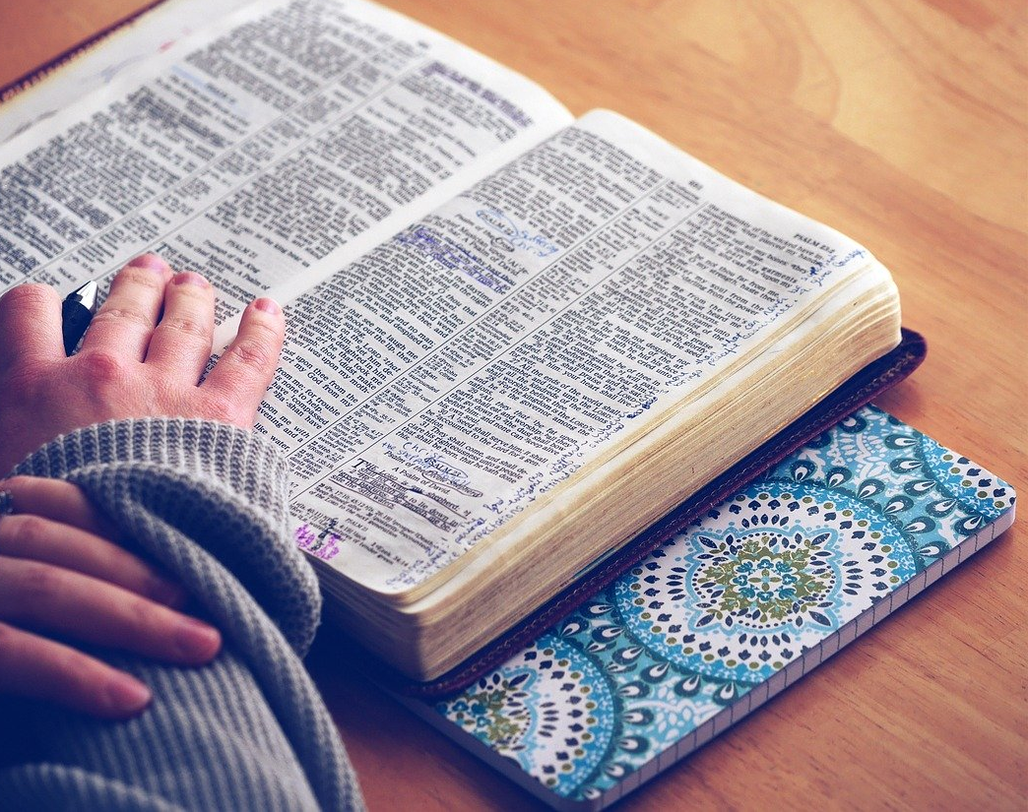
Listening to God
Life 101 Session 2 – How to know God

Slide 2
Listening to God
The Bible has 66 books
Divided into 2 sections
Old Testament: 39 books
New Testament : 27 books
One clear message :
God has a plan of redemption
He wants to restore us back to a relationship with Him

Slide 3
The Bible
Written over 1600 years (1500BC to AD90)
Around 40 different writers
Guided by the Holy Spirit
B.C: Before Christ
A.D: Anno Domini (Latin in the year of the Lord)

Slide 4
Trinity(3-in-1)
God the Father
God the Son, Jesus Christ
God the Holy Spirit

Slide 5
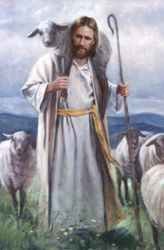
The Lord is our Shepherd
John 10:27
My sheep listen to my voice; I know them, and they follow me.

Slide 6
Daily Devotion or Quiet Time
Mark 1: 35-37
Very early in the morning, while it was still dark, Jesus got up, left the house and went off to a solitary place, where he prayed. ³⁶ Simon and his companions went to look for him, ³⁷ and when they found him, they exclaimed: ‘Everyone is looking for you!’

Slide 7
Daily Quiet Time
God wants to speak to us daily
We will find strength
Be in the right heart and perspective
Because many things in life will happen

Slide 8
How to have daily devotion time
Choose an unhurried slot of time : 20-30 mins
Find a quiet place, free from distractions or interruptions
Quieten down your heart and mind
Ask God to speak to you as you read the bible
Have a bible reading plan
Book of Mark : 1 Chapter a day

Slide 9
Read this 4 Gospels in Sequence
Book of Mark
Book of John
Book of Matthew
Book of Luke

Slide 10
3 Questions – Observe, Interpret, Apply
What does the passage says about God?
1
What does the passage teach me about Christian living?
2
What does God want me to do?
3

Slide 11
Daily Devo
Listening to God as you read the Bible passages
Get a notebook or journal as reflections

Slide 12
Lets Try this
Matthew 6:31-33
So do not worry, saying, “What shall we eat?” or “What shall we drink?” or “What shall we wear?”
³² For the pagans run after all these things, and your heavenly Father knows that you need them.
³³ But seek first his kingdom and his righteousness, and all these things will be given to you as well.
³⁴ Therefore do not worry about tomorrow, for tomorrow will worry about itself. Each day has enough trouble of its own.

Slide 13
How do I know when God speaks to me
God speaks to you in your Heart
Not in an audible voice (very rarely, but can happen)
God is living in you through the Holy Spirit
John 14:26:
But the Helper, the Holy Spirit, whom the Father will send in My name, He will teach you all things, and bring to your remembrance all that I said to you.

Slide 14
Recognizing God’s voice
Does not contradicts what the Bible says
Its not evil
Is spontaneous
In a light and gentle wway
A thought, an idea
Through circumstances, people or dreams

Slide 15
Practice
Listen in
Listen in Silence
Confirm
Confirm God’s voice
Don’t be
Don’t be discouraged

